Slide 1
Finance and Risk Analytics
Nishad Purohit

Slide 2
Table of content
1. Introduction
1.1 Problem Statement
1.2 Business Goal
1.3 Data Dictionary
2. Python Libraries
2.1 Import Python Libraries
2.2 Suppress Warnings
2.3 Setting up Jupyter View
3. Reading & Understanding the data
3.1 Importing the input file
3.2 Inspecting the dataframe
3.3 Data Cleaning
3.4 Null Value Calculation
4. Exploratoray Data Analysis
4.1 Data Normalization
4.2 Data Visualization
4.3 Sector Wise Analysis
4.4 Calculation of Key Metrics
5. Portfolio Anlaysis
5.1 Patrick Jyengar Portfolio
5.2 Peter Jyengar Portfolio
6. Conclusion

Slide 3
Steps 1 to 3
In this project the first step was the introduction in which the basic goal of the project was mentioned.
To start the project, Libraries were imported initially, warnings were suppressed and jupyter view was set up.
The next part was getting the data in a form that I can be worked on. In order to do that, the data was imported into dataframes and cleaned. The null values were dealt with in this step.
After finishing all these three steps, the data was in a format that analysis of it could be done easily.

Slide 4
Step 4: EDA
As we had to create portfolios, it was very important to present the data in a visual format.
In order to do that, the normalization of the data was done.
After the normalization of the stocks, only 8 stocks gave 80% or more return.
Let us have a look at them.

Slide 5
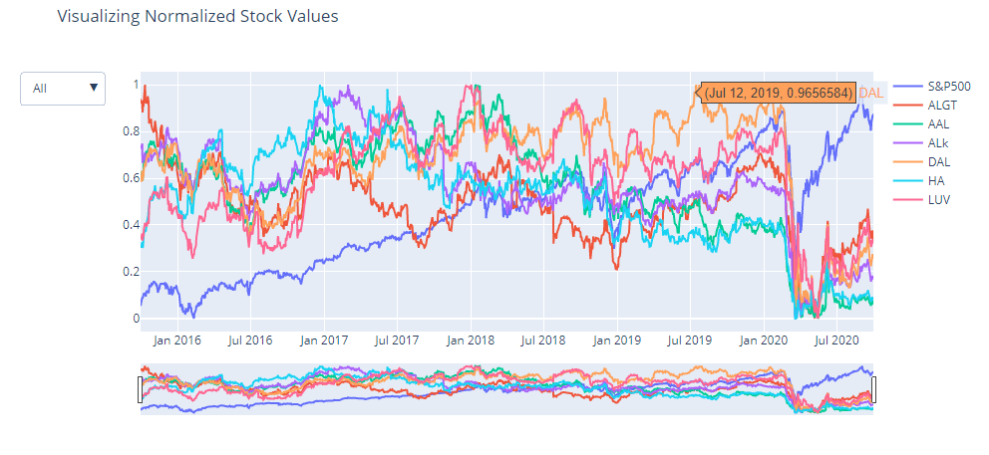
Sector Wise Analysis Aviation sector
Aviation Sector has faced major crisis in March 2020 due to Corona Pandemic and the aviation sector has not recovered there after even though the market index has gone up.

Slide 6
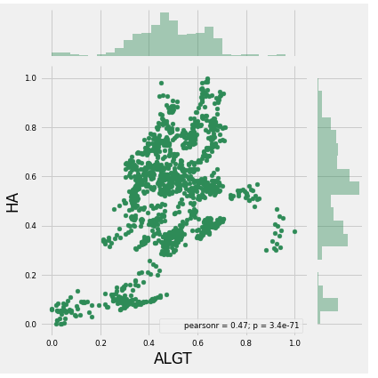
We can see that pearson coefficint = 0.47.If p-value is close to 1 it means higher positive correlation. If the p values is close to -1 then it means the stock prices have a higher negative correlation.
So we can conclude that HA and ALGT stock prices have less positive correlation.

Slide 7
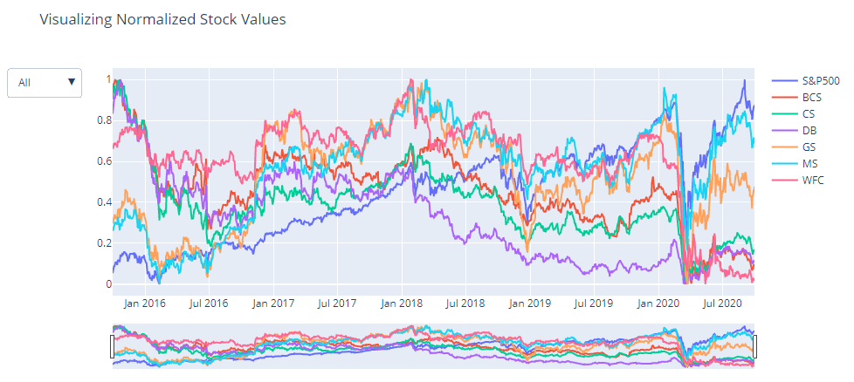
Finance Sector
Finance Sector has also faced a crisis in March 2020 due to Corona Pandemic and the Finance sector has recovered a bit although the majority of stocks have been hit.
Morgan Stanley & Goldman Sachs have performed well when compared to other stocks

Slide 8
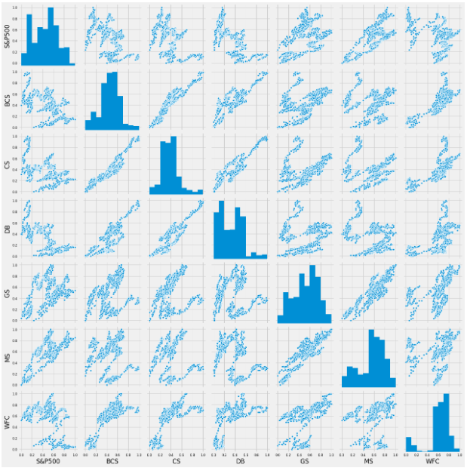
Here we can see that Goldman Sachs & Morgan stanley are highly correlated when compared to others stocks

Slide 9
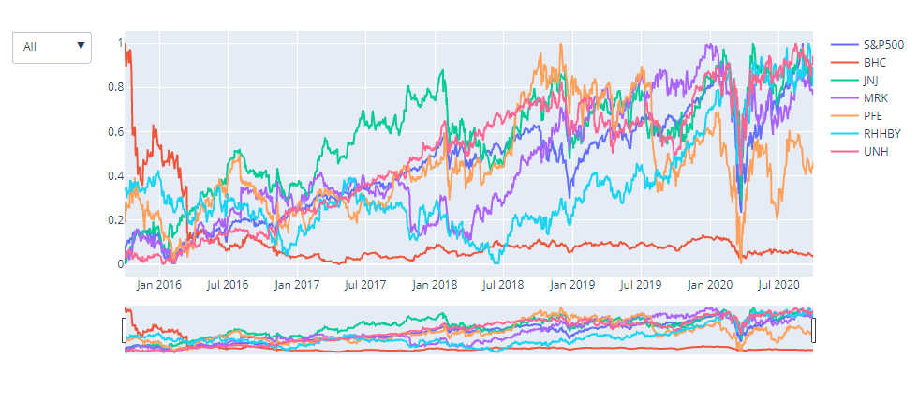
Pharma Sector
Pharma & Health care Sector has also faced a crisis in March 2020 due to Corona Pandemic but the recovery rate shown by this sector is commendable.
United Health, Johnson & Johnson have performed well when compared to S&P Index.
Bausch Health is consistently performed very badly over the years when compared to other stocks in the same sector.

Slide 10
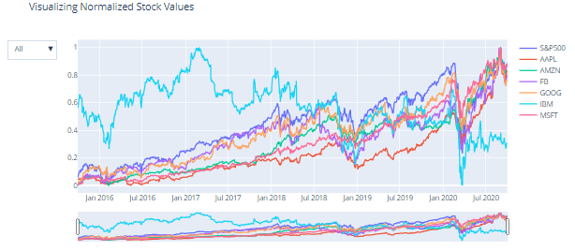
Technology Sector
Technology Sector has also faced a crisis in March 2020 due to Covid Pandemic but the recovery rate shown by this sector is commendable.
Microsoft, Amazon, Apple, Facebook & Google have performed well along with the Market index.
IBM is consistently performed very badly over the years when compared to other stocks in the same sector.

Slide 11
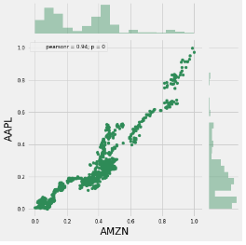
We can see that pearson coefficient = 0.94. If the p-value is close to 1 it means a higher positive correlation. If the p-value is close to -1 then it means the stock prices have a higher negative correlation. So we can conclude that Apple and Amazon stock prices have a high positive correlation.

Slide 12
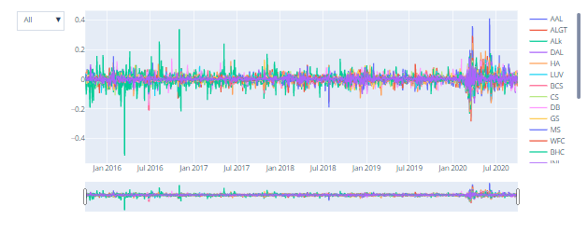
Daily returns
A return, also known as a financial return, in its simplest terms, is the money made or lost on an investment over some period of time.
A return is a percentage defined as the change of price expressed as a fraction of the initial price.
Returns exhibit more attractive statistical properties than asset prices themselves. Therefore it also makes more statistical sense to analyze return data rather than price series.
We will use formula and pandas built in function pct_change to compute the simple returns for each day, each stock in our dataset.

Slide 13
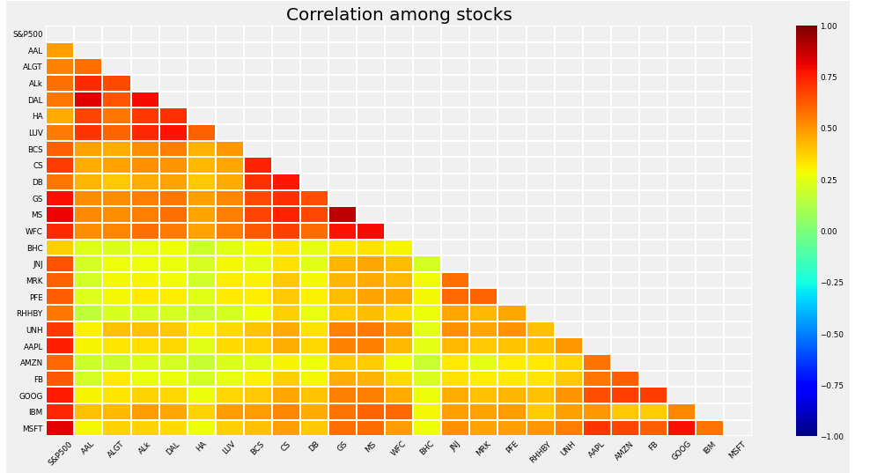
From the above Graph we can see that
Microsoft & Google stocks are highly correlated in the Techonolgy Stocks
Goldman Sachs, Morgan Stanley & WellsFargo are correlated in the Finance Stocks
American Airlines & Delta Airlines are more correlated than Alaska Air Group in the Aviation stocks
Pharma stocks are less correlated when comapred to any other sector stocks

Slide 14
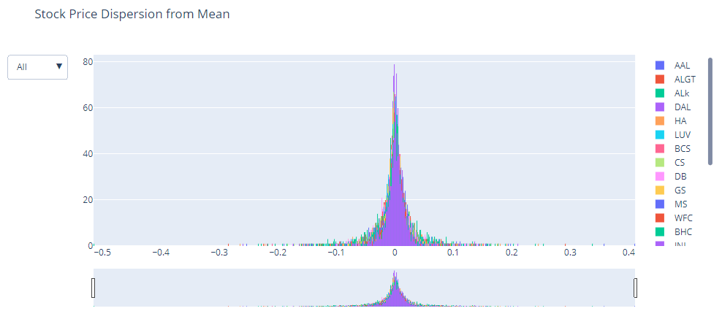
We can see that most of
the Daily returns value is
centred around zero.

Slide 15
Calculation of Sharpe Ratio, Annual Risk & Annaul returns
AMZN gives 40.59% annual returns
MSFT gives 34.95% annual returns
AAPL gives 33.32% annual returns
FB gives 26.45% annual returns
UNH gives 23.72% annual returns
GOOG gives 21.02% annual returns
MS gives 14.55% annual returns
S&P500 gives 13.04% annual returns

Slide 16
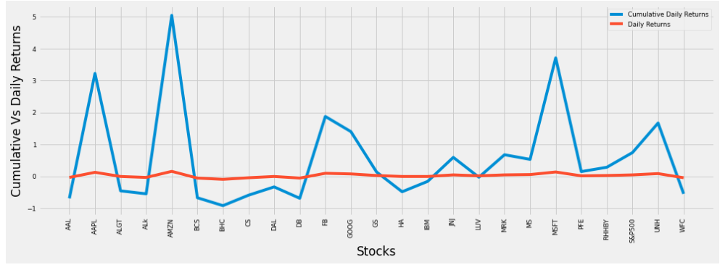
Cumulative vs Daily returns
We can see that Apple, Amazon, Facebook, Google, Micrososft, United health have given better daily returns.

Slide 17
Patrick Jyengar Portfolio
Mr. Patrick Jyengar wants to double his investment in the span on 5 years. He wants to invest in low risk stocks which would fetch him decent returns.
As per his profile Low risk stocks like JNJ,RHHBY and MRK is suitable to invest on. But overall returns with these three stocks wouldn't reach the target what Mr.Patrick is investing for. So one portion of his wealth can be invested on MSFT to gain the desired returns.
Mr.Patrick jyengar invests 500 Thousand Dollar on equities i.e the above Portfolio. Returns that he would fetch after 5 years is 1.58 Million Dollar with 558.23 Thousand dollar of gain

Slide 18
Peter Jyengar Portfolio
Mr. Peter Jyengar on the other hand Consistent with his attitude towards risk, he prefers high-return investments. Believes that he can still bounce back in case of any occasional losses. He Wants to invest $1 million from company’s cash and cash equivalents in the most high-margin stacksExpects high returns within 5 years for the inorganic expansion of his company. As per his profile High risk/High Returns stocks like AMZN and MSFT is suitable to invest on. Overall returns with these stocks would fetch him Maximum returns and also cater the Risk
Mr.Peter jyengar invests 1 Million Dollar on equities i.e the above Portfolio. Returns that he would fetch after 5 years is more than 6 Million Dollars with 5+ Million dollars of gain

Slide 19
Calculation of risk
The calculation of both the portfolios was done by several steps
Daily return from each stock
Average daily return from each stock
Risk of Stocks in Portfolio
Daily return from the portfolio
Total Portfolio Return
Cumulative return from the Portfolio
Portfolio Risk – Portfolio Standard Deviation
Sharpe Ratio
Total ROI from the Portfolio

Slide 20
Conclusion
In this attached Notebook we have explored stock prices of tech stocks, pharma stocks, Aviation stocks, finance stocks & market Index also. We have looked at the historical price of stock price.We have looked at the volume of stock traded.
We have looked at the daily Return of stock.We have done correlation between the stock prices.Microsoft and Amazon have highest daily price correlation.maximum daily fluctuation in ths stock is 8 % .In stock exchange there is a limit on per day fluctuation of stock.So if the stock reaches the threshold value then the trading of the stock is stopped for that day.
Stock with Low risk and high return are the best stock to buy. We can see that Amazon Stock has high risk and high returns.

